Slide 1



Monthly Steerco 7 - 16/09/2022
Eyecloud HAMR
Main actions and events
Infra side:
CIN/DEV/TIN/QUA/PPR/PRD :
INFRA in Ireland → DONE.
INFRA in Canada (only for QUA/PPR/PRD) → DONE
New DNS for V3 → DONE
Set the traffic policy (geo-proximity) to be able to route the traffic automatically (only for QUA/PPR/PRD) → DONE
Change the traffic policy from “geoProximity” to “geoLocation” (only for QUA/PPR/PRD) → DONE
Application side :
Creation of dedicated pipelines for Build and Release
Creation of new user data script
Remove the ID type from the API Requests
Reinforcement of the ID
Generation of ID depending on the Region
Adding the region info in the healthcheck
Implementation – > DONE
Deployment and Test :
DEV/TIN – RIFT:
Deployment – > DONE
Test – > DONE
QUA (CA and IR) – RIOS:
Deployment – > DONE
Test – > DONE
PPR (CA and IR) – RICS :
Deployment – > DONE
Test– > DONE
PRD (CA and IR) →RICS
Deployment → DONE
Test →DONE
The STEP 1(Set the infra replication to canada) is completed. The next action is to start Discussion about current users migration from V1/V2 to V3
The next STEP is the authentication :
First, Change from “actor/application key” to “api key” with api gateway
Then, Set an OAUTH2 mechanism
Questions / Remarks / Risks
eyecloud HAMR - Steerco meeting
Blocage
Risque
Conforme

Slide 2
Monthly Steerco 6 - 22/07/2022
Eyecloud HAMR
Main actions and events
Infra side:
CIN/DEV/TIN (only in Ireland) → DONE.
QUA (canada and ireland) → DONE
PPR (canada and ireland) → DONE
PRD :
INFRA in Ireland → DONE.
INFRA in Canada→ DONE
New DNS for V3 → DONE
Set the traffic policy (geo-proximity) to be able to route the traffic automatically → DONE
Application side :
Creation of dedicated pipelines for Build and Release
Creation of new user data script
Remove the ID type from the API Requests
Reinforcement of the ID
Generation of ID depending on the Region
Adding the region info in the healthcheck
DEV/TIN → DONE
QUA → DONE
PPR → DONE
PRD → DONE
Implementation – > DONE
Deployment and Test :
DEV/TIN – RIFT:
Deployment – > DONE
Test – > DONE
QUA (CA and IR) – RIOS:
Deployment – > DONE
Test – > DONE
PPR (CA and IR) – RICS :
Deployment – > DONE
Test– > DONE
PRD CA and IR) →RICS
Deployment → DONE
Test → In Progress
Today, the traffic policy has been set with GeoProximity → Shall we switch to GeoLocation ?
Questions / Remarks / Risks
eyecloud HAMR - Steerco meeting
Blocage
Risque
Conforme

Slide 3
Monthly Steerco 5 - 28/06/2022
Eyecloud HAMR
Main actions and events
Infra side:
CIN/DEV/TIN (only in Ireland) → DONE.
QUA (canada and ireland) → DONE
PPR
INFRA in Ireland → DONE.
INFRA in Canada→ DONE
New DNS for V3 → DONE
Set the traffic policy (geo-proximity) to be able to route the traffic automatically → Set by CCOE (test in progress)
PRD : Tasks about infrastructure creation will be added in the CCOE’s backlog once validation on PPR will be done (expected this week)
Application side :
Creation of dedicated pipelines for Build and Release
Creation of new user data script
Remove the ID type from the API Requests
Reinforcement of the ID
Generation of ID depending on the Region
Adding the region info in the healthcheck
DEV/TIN → DONE
QUA → DONE
PPR → TO be deployed
Implementation – > DONE
Deployment and Test :
DEV/TIN – RIFT:
Deployment – > DONE
Test – > DONE
QUA (CA and IR) – RIOS:
Deployment – > DONE
Test – > DONE
PPR (CA and IR) – RICS :
Deployment – > DONE
Test– > DONE
Questions / Remarks / Risks
eyecloud HAMR - Steerco meeting
Blocage
Risque
Conforme

Slide 4
Monthly Steerco 4 - 20/05/2022
Eyecloud HAMR
Main actions and events
Infra side:
CIN/DEV/TIN (only in Ireland) → DONE.
QUA (canada and ireland) → DONE
PPR
INFRA in Ireland → DONE.
INFRA in Canada→ DONE
Set the traffic policy to be able to route the traffic automatically → IN PROGRESS
Application side :
Creation of dedicated pipelines for Build and Release
Creation of new user data script
Remove the ID type from the API Requests
Reinforcement of the ID
Generation of ID depending on the Region
Implementation – > DONE
Deployment and Test :
DEV/TIN – RIFT:
Deployment – > DONE
Test – > DONE
QUA (CA and IR) – RIOS:
Deployment – > DONE
Test – > DONE
PPR (CA and IR) – RICS :
Deployment – > DONE
Test – > TO DO
STEP 1 :
Traffic Policy activation is on hold in PPR :
We had to change the DNS for the V3. The Goal is to apply a specific DNS for the new V3 in order to avoid impacting the V1/V2 version with the new traffic policy. → DNS have been created on CIN/DEV/TIN and test are scheduled for next week.
Due to the issue faced in GDP with US and CANADA users with latency, we will probably switch from “Latency” to “Geoproximity” (or geolocation) route policy
Questions / Remarks / Risks
eyecloud HAMR - Steerco meeting
Blocage
Risque
Conforme

Slide 5
Monthly Steerco 3 - 15/04/2022
Eyecloud HAMR
Main actions and events
Infra side:
CIN/DEV/TIN (only in Ireland) → DONE.
QUA
Ireland → DONE.
Canada→ IN PROGRESS
Creation of bucket in canada region to store the files → DONE.
Set bi directional replication between ireland and canada buckets → DONE.
Set the global table feature in order to have dynamoDB in both Region → DONE.
Create a Replica of RDS (Mysql) for CANADA region → DONE.
Creation of new ASG in canada for eyecloud V3 → DONE.
Creation of a bucket to host package in canada → DONE.
Set the traffic policy to be able to route the traffic → IN PROGRESS
Application side :
Creation of dedicated pipelines for Build and Release
Creation of new user data script
Remove the ID type from the API Requests
Reinforcement of the ID
Generation of ID depending on the Region
Implementation – > DONE
Deployment and Test :
DEV/TIN :
Deployment – > DONE
Test – > DONE
QUA (CA and IR) :
Deployment – > DONE
Test – > DONE
STEP 1 :
Traffic Policy setting is in progress : Souad is waiting the support of AWS in order to increase the quotas of records within traffic policy
Next step is setting the infra on PPR
STEP 2 :
Rashmi will leave the company on20th of April. She has been the developer of eyecloud and authz
Questions / Remarks / Risks
eyecloud HAMR - Steerco meeting
Blocage
Risque
Conforme

Slide 6
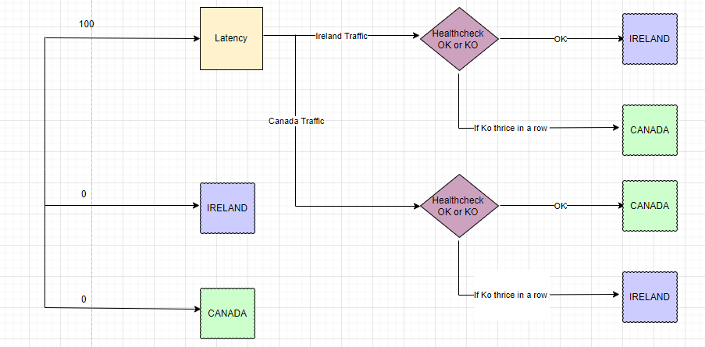
HAMR API Traffic Policy with Route53 on AWS

Slide 7
Monthly Steerco 2 - 18/03/2022
Eyecloud HAMR
Main actions and events
Infra side:
CIN/DEV/TIN (only in Ireland) → DONE.
QUA
Ireland → DONE.
Canada→ TO DO (tasks have been added in the CCOE backlog) :
Creation of bucket in canada region to store the files
Set bi directional replication between ireland and canada buckets
Set the Route 53 to be able to route the traffic (metrics have to be defined)
Set the global table feature in order to have dynamo DB in both Region
Creation of new ASG in canada for eyecloud V3
Creation of a bucket to host package in canada
Application side :
Creation of dedicated pipelines for Build and Release
Creation of new user data script
Remove the ID type from the API Requests
Reinforcement of the ID
Generation of ID depending on the Region
Implementation – > DONE
Deployment and Test :
DEV/TIN :
Deployment – > DONE
Test – > DONE
QUA IR :
Deployment – > DONE
Test → IN PROGRESS
STEP 1 :
The infra has to be set up in QUA canada.
STEP 2 :
“Analysis” user stories have been created in the current sprint, in order to identify the change that we have to do in application side :
For the authentication part : change from “actor_key/application_key” to “Api_key” with Api gateway.
For Authorization part : migration to Authz
Rashmi will leave the company on end of March. who has been the developer of eyecloud and authz
Questions / Remarks / Risks
eyecloud HAMR - Steerco meeting
Blocage
Risque
Conforme

Slide 8
Monthly Steerco 1 - 18/02/2022
Eyecloud HAMR
Main actions and events
Infra AWS :
Dynamo DBs and Buckets :
CIN / DEV → DONE.
Next step, Set infra in TIN (Ticket has been added in the CCOE backlog)
APPlication :
Implementation of the V3 :
Current sprint
Creation of dedicated pipelines for Build and Release →DONE
Creation of new user data script → IN PROGRESS
Remove the ID type from the API Requests → TO DO
Next Sprint
Reinforcement of the ID
Generation of ID depending on the Region
STEP 1 :
The infra has to be set up in TIN for the test purpose (from RIFT team) → CCOE’s members are fully busy working massively on GDP migration. They won’t be available next week for this task. We will validate the implementation on dev env for now.
STEP 2 :
For the authentication part : we will align with what will be done on GDP topic. So probably:
First, Set the “api key” process
Then, set the Oauth2 with a dedicated ID provider
Rashmi will leave the company on end of March. who has been the developer of eyecloud and authz
Questions / Remarks / Risks
eyecloud HAMR - Steerco meeting
Blocage
Risque
Conforme

Slide 9
RoadMap
2021 |  | 2022
November | December | Q1 | Q2 | Q3 | Q4
Scoping STEP
Conception and Realization STEP 1
Route 53
Scoping / Requirements
ASGs duplication
S3 Replication
Global table in Dynamo DBs
I
Id uniqueness enhancement
0
Discussion with users
Realization
Conception and Realization STEP 2
Authentication
Authorization

